Slide 1
Topics to be Covered
Orders of Growth (Briefly)
  Big Oh Notation
  Omega Notation
  Theta Notation
Master Method
  Divide-and-Conquer Recurrence Relations
Master Theorem
  General Case

Slide 2
Orders of Growth
Complexity: the amount of time and/or space needed to execute the algorithm.
Complexity may be expressed in terms of its relationships to some known functions.

Slide 3
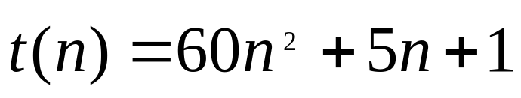
Types of complexity
  Consider the function,
n | t(n) = 60n² + 5n + 1 | 60n² ^{(lower limit)} | 66n² ^{(upper limit)}
10 | 6,051 | 6,000 | 6,600
100 | 600,501 | 600,000 | 660,000
1,000 | 60,005, 001 | 60,000,000 | 66,000,000
10,000 | 6,000,050,001 | 6,000,000,000 | 6,600,000,000

Slide 4
Types of Complexity: Big Oh
Definition: Big Oh Notation
Let f and g be functions with domain {1,2,3,….}
f(n) = O( g(n))
We say that “f(n) is of order at most g(n)” if there exist a positive constant C₁ such that
|f(n)| ≤ C₁|g(n)|
for all but finitely many positive integers n.

Slide 5
Types of Complexity: Omega Notation
Definition: Omega Notation
Let f and g be functions with domain {1,2,3,….}
f(n) = Ω( g(n))
We say that “f(n) is of order at least g(n)” if there exist a positive constant C₁ such that
|f(n)| ≥ C₁|g(n)|
for all but finitely many positive integers n.

Slide 6
Types of Complexity: Theta Notation
Definition: Theta Notation
Let f and g be functions with domain {1,2,3,….}
f(n) = θ( g(n))
We say that “f(n) is of order g(n)” if
f(n) = Ω( g(n)) and f(n) = O( g(n))
C₁|g(n)| ≤ |f(n)| ≤ C₂|g(n)|
for all but finitely many positive integers n.

Slide 7
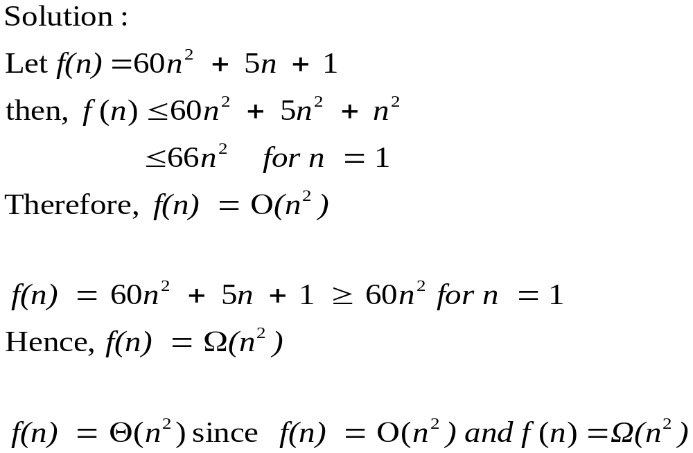
Complexity of Polynomial Functions
Example: Show that 60n² + 5n + 1 is of order n²

Slide 8
Types of Complexity
Consider the following graphs…
Determine the relation between any pair i.e. O, Ω or Θ
f(x) | 1/x | 1 | log(log (x)) | log (x) | log (x)*log(x) | x | x*log(x) | x*x

Slide 9
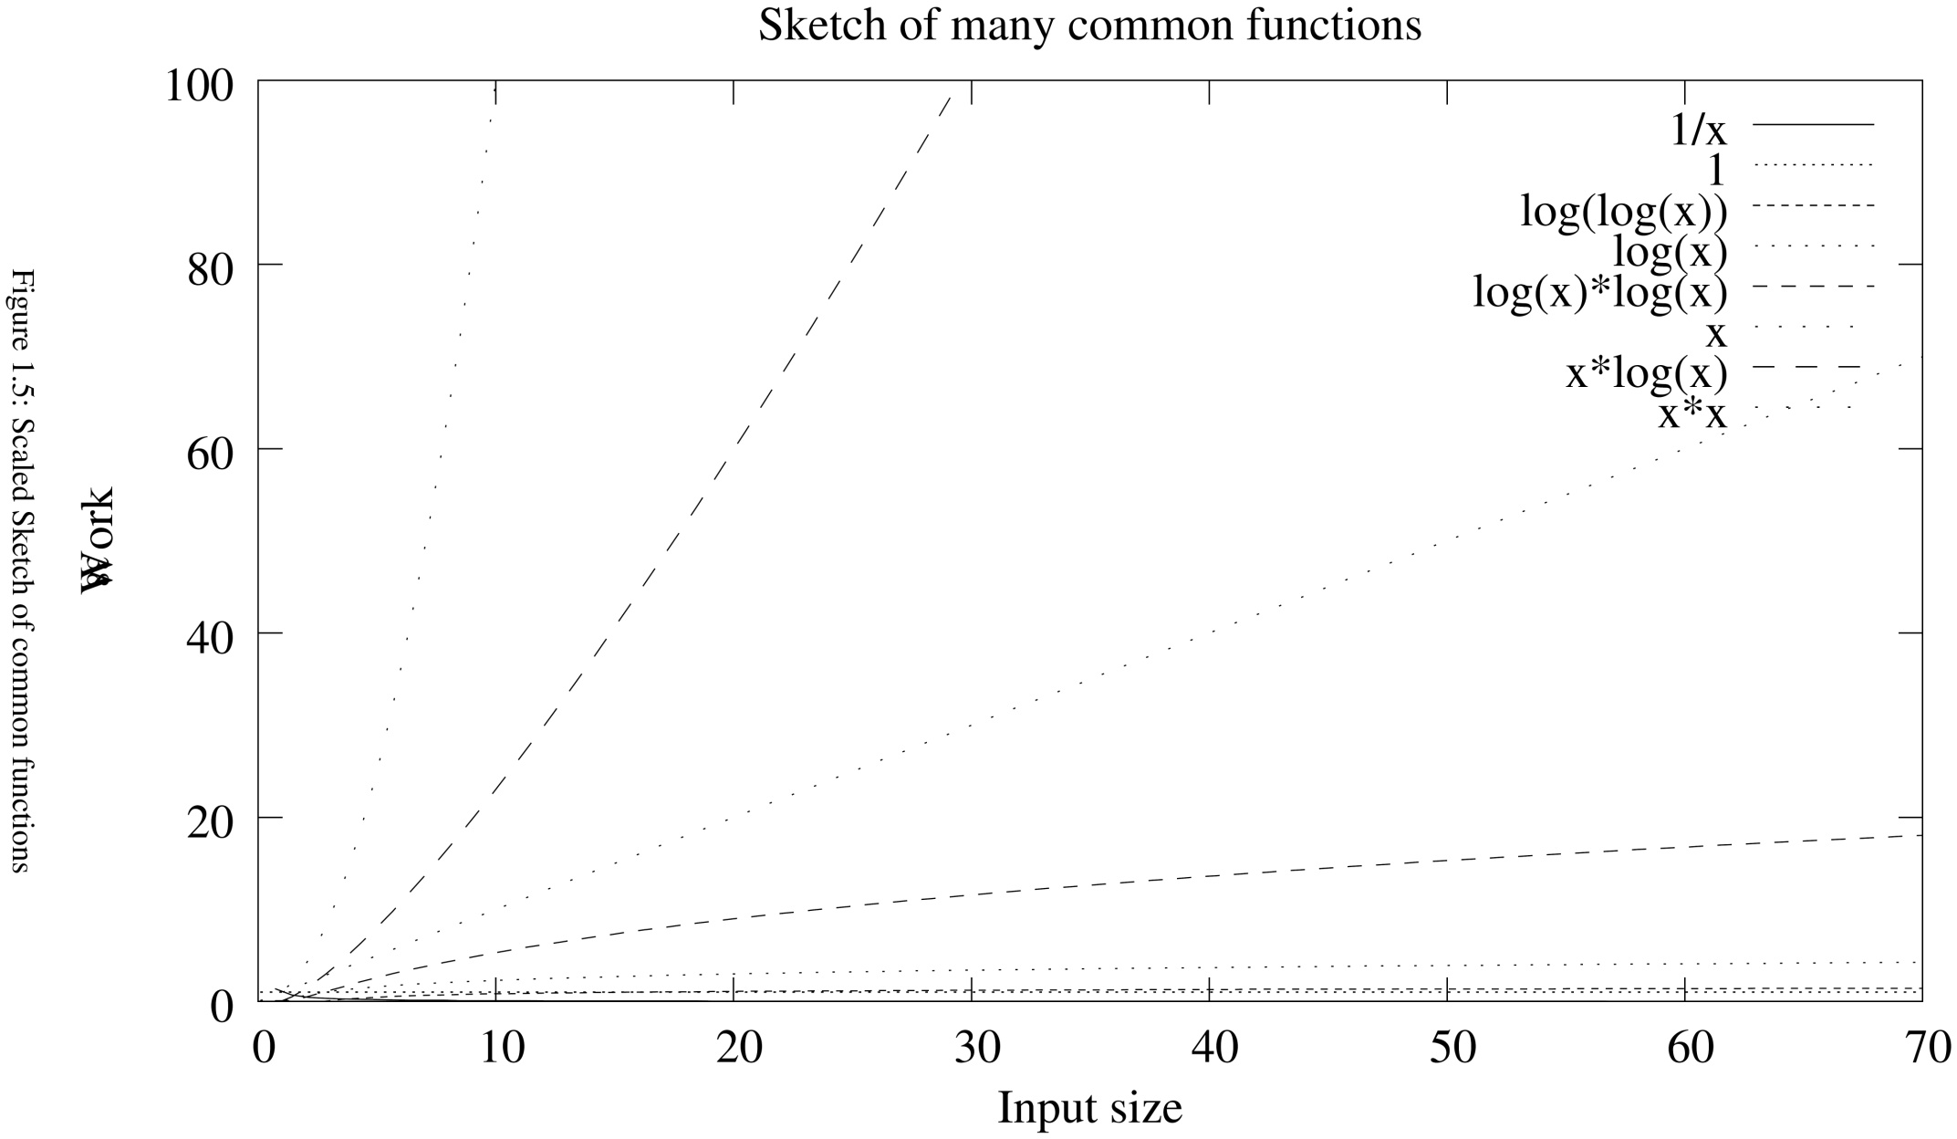




Types of Complexity
Example: Show that 60n² + 5n + 1 is of order n²

Slide 10
Types of Complexity
Consider the following graphs…
Results: 1/x = O(1), x = Ω(log(x)), log(x)*log(x) = O(x*x)
f(x) | 1/x | 1 | log(log (x)) | log (x) | log (x)*log(x) | x | x*log(x) | x*x
1 | 1 | 1 | - | 0 | 0 | 1 | 0 | 1
5 | 0.2 | 1 | -0.16 | 0.7 | 0.5 | 5 | 4 | 25
10 | 0.1 | 1 | 0 | 1 | 1 | 10 | 10 | 100
15 | 0.07 | 1 | 0.07 | 1.2 | 1.4 | 15 | 18 | 225
20 | 0.05 | 1 | 0.11 | 1.3 | 1.7 | 20 | 26 | 400
100 | 0.01 | 1 | 0.30 | 2 | 4 | 100 | 200 | 10000
1000 | 0.001 | 1 | 0.48 | 3 | 9 | 1000 | 3000 | 1000000

Slide 11
Master Method
Divide-and-Conquer Recurrence Relations
Suppose that a recursive algorithm divides a problem of size n into a subproblems,
Where each subproblem is of size n/b
  for simplicity, we assume that n is a multiple of b; in reality the smaller problems are often of size equal to the nearest integers ≤ or ≥ n/b
Suppose that a total of g(n) extra operations are required in the conquer step of the algorithm to combine the solutions of the subproblems into a solution of the original problem…

Slide 12
Master Method
Divide-and-Conquer Recurrence Relations
Then…
If f(n) represents the number of operations required to solve the problem of size n,
It follows that f satisfies the recurrent relation
f(n) = af(n/b) + g(n)
Sometimes written as
T(n) = aT(n/b) + f(n)

Slide 13
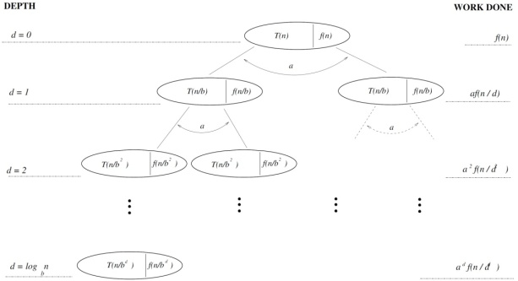
Master Method
Consider solving via a Recursion Tree, using
T(n) = aT(n/b) + f(n)
The objective is to sum the overheads over the entire tree.
The expression we obtain (in terms of n) is the (closed form) expression of T(n) or f(n) for the other form of the formula.
The approach we use is to calculate the total work done per level of the tree.

Slide 14

Master Method
A Generic Recursion Tree…
Calculating the total work done per level of the tree…
The overhead at the root node is f(n).
The work done at the level just below the root, we see that there are a nodes, each of which incurs an overhead cost of f(n/b).So the total amount of work at that level is af(n/b).

Slide 15

Master Method
A Generic Recursion Tree…
a ² f(n / d ²)
a ^{d} f(n / d ^{d})

Slide 16
Master Method
A Generic Recursion Tree…
Repeating the reasoning for the next levels
The total amount of work for level 2 is a²f(n/b²).
In general, at depth i, the total work done is
a^{i}f(n/b^{i}).
If we define the root level to be depth 0, then we can say that at depth i we have a^{i} nodes.
So if we can calculate d, the (maximum) depth of the tree, then the number of leaves is a^{d}.
So what is the value of d, the depth of the tree.

Slide 17
Master Method
A Generic Recursion Tree…
Calculating the depth, d
From the original definition of the problem
“where each subproblem is of size n/b”
We can write n/b^{d} ≤ 1
Solving for d:
n/b^{d} ≤ 1
n ≤ b^{d}
log n ≤ d log b
log n / log b ≤ d
log_{b}n ≤ d
d ≥ log_{b}n
Therefore the number of leaves at a level is a^{logbn}

Slide 18
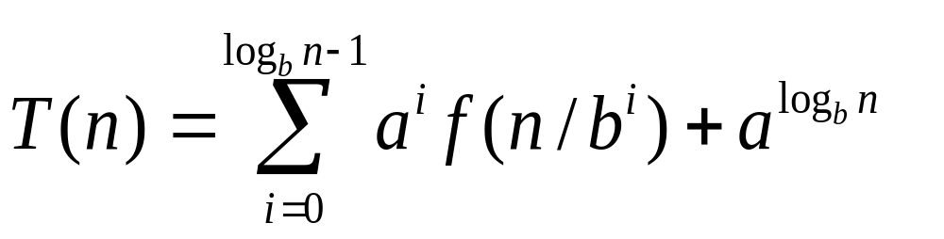
Master Method
A Generic Recursion Tree…
Determining the final T(n)
Summing the expressions (internal nodes and leaves), we have…

Slide 19
Theorem
Let f be an increasing function that satisfies the recurrence relation
f(n) = af(n/b) + c
whenever n is divisible by b,
where a ≥ 1, b is an integer > 1, and
c is a positive real number
Then
O(n^{logba}) if a > 1,
f(n) is
O(log n) if a = 1.
Furthermore, when n=b^{k}, where k is a positive integer,
f(n) = C₁f(n/b) + C₂
where C₁ = f(1)+c/(a-1) and C₂ = -c/(a-1).

Slide 20
Master Method - Example
Let a,b,c be integers such that a ≥ 1, b > 1 and c > 0. Let f: N → R be functions, such that
f(1) = c
f(n) = af(n/b) + c
for n = b^{m}, where m is a positive integer greater than 1.
Show that
if a = 1, then
f(n) = c(log_{b}n + 1) = Θ(log_{b}n)

Slide 21
Master Method - Example
Firstly,
By using the principles of Recurrence Relation, find a general formula for f(n)
Secondly
Show that
if a = 1, then
f(n) = c(log_{b}n + 1) = Θ(log_{b}n)

Slide 22
Master Method - Example
Firstly,
By using the principles of Recurrence Relation, find a general formula for f(n)
Solution
f(n) = a f(n/b) + c .....1
= a [a f(n/b² ) + c] + c
As f(n/b) = a f(n/b² ) + c
f(n) = a² f(n/b²) + c(a + 1) .....2
...

Slide 23
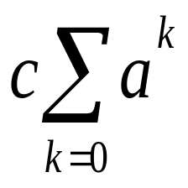
Master Method - Example
f(n) = a² f(n/b²) + c(a + 1) .....2
= a² [a f(n/b³) + c] + c(a + 1)
As f(n/b²) = a f(n/b³ ) + c
f(n) = a³ f(n/b³) + c(a²+a+1) .....3
= a³ [a f(n/ b⁴) + c] + c(a²+a+1)
As f(n/b³) = a f(n/b⁴ ) + c
f(n) = a⁴ f(n/b⁴) + c(a³+a²+a +1) .....4
= ......
m-1
f(n) = a^{m} f(n/b^{m} ) +
where m ≥ 1

Slide 24
Master Method - Example
Secondly
Show that for n = b^{m},
if a = 1, then
f(n) = c(log_{b}n + 1) = Θ(log_{b}n)
Solution
m-1
f(n) = a^{m} f(n/b^{m} ) + , where m≥1
As n = b^{m}
n/b^{m} = 1 AND log_{b} n = m

Slide 25
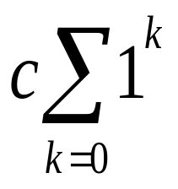
Master Method - Example
As m = log_{b} n AND n/b^{m} = 1 AND if a = 1 AND f(1) = c
m-1
f(n) = 1^{m} * f(1) +
= 1^{m} * f(1) + c * m*1
As f(1) = c, and m = log_{b} n
f(n) = c + c log_{b} n
f(n) = c(log_{b} n + 1)
PROVEN

Slide 26
Master Method - Example
Now, given
f(n) = c(log_{b}n + 1)
Prove
f(n) = c(log_{b}n + 1) = Θ(log_{b}n)
Solution
Further, as log_{b} n = m AND m > 1
f(n) ≤ c(log_{b} n + log_{b} n )
f(n) ≤ 2c log_{b} n
f(n) = O (log_{b} n )

Slide 27
Master Method - Example
Now, given
f(n) = c(log_{b}n + 1)
Prove
f(n) = c(log_{b}n + 1) = Θ(log_{b}n)
Solution
Likewise
f(n) ≥ c log_{b} n
f(n) = Ω (log_{b} n )
Hence
f(n) = ϴ (log_{b} n )

Slide 28
Master Theorem
Let f be an increasing function that satisfies the recurrence relation
f(n) = af(n/b) + cn^{d}
whenever n = b^{k},
where k is a positive integer,
a ≥ 1,
b is an integer > 1, and
c is a positive real number
d is a nonnegative real number
Then
O(n^{d}) if a < b^{d},
f(n) is O(n^{d}log n) if a = b^{d},
O(n^{logba}) if a > b^{d}.

Slide 29
Master Theorem
Let f be an increasing function that satisfies the recurrence relation
f(n) = af(n/b) + g(n)
where a, b are constants, and
g(n) is an arbitrary function in n
Let E = log_{b}a (E is called the critical exponent)
There are three (3) Cases.

Slide 30
Master Method - Recall
A Generic Recursion Tree…
Determining the final T(n)
Summing the expressions (internal nodes and leaves), we have…

Slide 31
Master Method - Recall
A Generic Recursion Tree…
a ² f(n / d ²)
a ^{d} f(n / d ^{d})

Slide 32
Master Theorem - Recall
Let f be an increasing function that satisfies the recurrence relation
f(n) = af(n/b) + g(n)
where a, b are constants, and
g(n) is an arbitrary function in n
Let E = log_{b}a (E is called the critical exponent)
There are three (3) Cases.

Slide 33
Master Theorem
The Master Theorem applies to recurrences of the form:
f(n) = af(n/b) + g(n)
where a ≥ 1, and b > 1 are constants, and
g(n) is an asymptotically positive function
Let E = log_{b}a (E is called the critical exponent)
These are the three (3) Cases.
Case 1: When the work done at the leaves overwhelms that done at the internal nodes. So the overall work done is of the order a^{logbn} = n^{logba}
Rule:
If for some ϵ > 0, and g(n) = O(n^{E-ϵ}), then
f(n) = Θ(n^{E})

Slide 34
Master Theorem
The Master Theorem applies to recurrences of the form:
f(n) = af(n/b) + g(n)
where a ≥ 1, and b > 1 are constants, and
g(n) is an asymptotically positive function
Let E = log_{b}a (E is called the critical exponent)
These are the three (3) Cases.
Case 2: When each level of the recursion tree contributes about the same amount of work as the leaves. Therefore a^{i}f(n/b^{i}) = Θn^{logba}
Rule:
If g(n) = Θ(n^{E}), then
f(n) = Θ(g(n) log n)

Slide 35
Master Theorem
The Master Theorem applies to recurrences of the form:
f(n) = af(n/b) + g(n)
where a ≥ 1, and b > 1 are constants, and
g(n) is an asymptotically positive function
Let E = log_{b}a (E is called the critical exponent)
These are the three (3) Cases.
Case 3: When work at root is more than that at leaves.
Rule:
If for some ϵ > 0, and g(n) = Ω(n^{E+ϵ}), and
g(n) satisfies the Regularity condition, then
f(n) = Θ(g(n))
Regularity condition: ag(n/b) ≤ cg(n) for some constant c<1 and all sufficiently large n.

Slide 36
Master Theorem
The Master Theorem applies to recurrences of the form:
f(n) = af(n/b) + g(n)
where a ≥ 1, and b > 1 are constants, and
g(n) is an asymptotically positive function
Let E = log_{b}a (E is called the critical exponent)
These are the three (3) Cases.
Case 1: If for some ϵ > 0, and g(n) = O(n^{E-ϵ}), then
f(n) = Θ(n^{E})
Case 2: If g(n) = Θ(n^{E} log^{k}n) with k≥0, then
f(n) = Θ(n^{E} log^{k+1}n)
Case 3: If for some ϵ > 0, and g(n) = Ω(n^{E+ϵ}), and
g(n) satisfies the Regularity condition, then
f(n) = Θ(g(n))

Slide 37
Master Theorem - Recall
Divide-and-Conquer Recurrence Relations
f(n) = af(n/b) + g(n)
Sometimes written as
T(n) = aT(n/b) + f(n)

Slide 38
Master Theorem - Restated
The Master Theorem applies to recurrences of the form:
T(n) = aT(n/b) + f(n)
where a ≥ 1, and b > 1 are constants, and
g(n) is an asymptotically positive function
Let E = log_{b}a (E is called the critical exponent)
These are the three (3) Cases.
Case 1: If for some ϵ > 0, and f(n) = O(n^{E-ϵ}), then
T(n) = Θ(n^{E})
Case 2: If f(n) = Θ(n^{E}), then
T(n) = Θ(f(n) log n)
Case 3: If for some ϵ > 0, and f(n) = Ω(n^{E+ϵ}), and
f(n) satisfies the Regularity condition, then
T(n) = Θ(f(n))

Slide 39
Master Theorem – Example 1
Solve the following problem using Master Theorem:
T(n) = 3T(n/4) + n log n
Solution
Consider the recurrence:
T(n) = aT(n/b) + f(n)
where a, b are constants and f(n) is an arbitrary function,
let the critical exponent, E = log_{b}a
Given
T(n) = 3T(n/4) + n log n
The critical exponent, E
E = log₄3 = log₄4^{0.792} = 0.792 ≈ 0.8
. . .

Slide 40
Master Theorem – Example 1
Solve the following problem using Master Theorem:
T(n) = 3T(n/4) + n log n
Solution continued
. . .
By examining the overhead function f(n) with n^{E}
f(n) = n log n and n^{E} = n^{0.8}
Therefore
f(n) = n log n = Ω(n^{E}) = Ω(n^{0.8})
We are on track for Master Theorem Case 3, if
(1) We can find ϵ > 0 that allows f(n) = Ω(n^{E+ϵ})
AND
(2) af(n/b) ≤ cf(n) for some constant c<1
. . .

Slide 41
Master Theorem – Example 1
Solve the following problem using Master Theorem:
T(n) = 3T(n/4) + n log n
Solution continued
. . .
(1) We find ϵ > 0 that allows f(n) = Ω(n^{E+ϵ})
For definiteness, let ϵ = 0.1
E + ϵ = 0.8 + 0.1 = 0.9
It is clear that
f(n) = n log n = Ω(n^{E+ϵ}) = Ω(n^{0.9})
AND
(2) af(n/b) ≤ cf(n) for some constant c<1
As a=3, b=4, f(n) = n log n, it is clear that
3(n/4) log (n/4) ≤ c n log n for some c=0.9
. . .

Slide 42
Master Theorem – Example 1
Solve the following problem using Master Theorem:
T(n) = 3T(n/4) + n log n
Solution continued
. . .
As for some ϵ > 0, and f(n) = Ω(n^{E+ϵ}), and
f(n) satisfies the Regularity condition
ag(n/b) ≤ cg(n) for some constant c<1 and all sufficiently large n
Master Theorem Case 3 holds
We conclude that
the solution for the given equation
T(n) = 3T(n/4) + n log n
is
T(n) = Θ(f(n))
T(n) = Θ(n log n)

Slide 43
Master Theorem – Example 2
Solve the following problem using Master Theorem:
T(n) = 4T(n/2) + n
Solution
Consider the recurrence:
T(n) = aT(n/b) + f(n)
where a, b are constants and f(n) is an arbitrary function,
let the critical exponent, E = log_{b}a
Given
T(n) = 4T(n/2) + n
The critical exponent, E
E = log₂4 = 2
. . .

Slide 44
Master Theorem – Example 2
Solve the following problem using Master Theorem:
T(n) = 4T(n/2) + n
Solution continued
. . .
By examining the overhead function f(n) with n^{E}
f(n) = n and n^{E} = n²
Therefore
f(n) = n = O(n^{E}) = O(n²)
We find ϵ that allows f(n) = O(n^{E-ϵ})
For definiteness, let ϵ = 0.5
E - ϵ = 2 - 0.5 = 1.5
It is clear that
f(n) = n = O(n^{E-ϵ}) = O(n^{1.5})
. . .

Slide 45
Master Theorem – Example 2
Solve the following problem using Master Theorem:
T(n) = 4T(n/2) + n
Solution
. . .
As for some ϵ > 0, and f(n) = O(n^{E-ϵ})
Master Theorem Case 1 holds
We conclude that
the solution for the given equation
T(n) = 4T(n/2) + n
is
T(n) = Θ(n^{E}) or T(n) = Θ(n^{logba})
T(n) = Θ(n^{log24})
T(n) = Θ(n²)

Slide 46
Master Theorem – Example 3
Solve the following problem using Master Theorem:
T(n) = 2T(n/2) + n log n
Solution
Consider the recurrence:
T(n) = aT(n/b) + f(n)
where a, b are constants and f(n) is an arbitrary function,
let the critical exponent, E = log_{b}a
Given
T(n) = 2T(n/2) + n
The critical exponent, E
E = log₂2 = 1
. . .

Slide 47
Master Theorem – Example 3
Solve the following problem using Master Theorem:
T(n) = 2T(n/2) + n log n
Solution continued
By examining the overhead function f(n) with n^{E}
f(n) = n log n and n^{E} = n¹
Therefore
f(n) = n log n = Θ(n^{E}) = Θ(n¹)
As f(n) = Θ(n^{E}), Master Theorem Case 2 holds
We conclude that
the solution for the given equation
T(n) = 2T(n/2) + n log n
is T(n) = Θ(n^{E}log^{k+1}n ) or T(n) = Θ(f(n)log^{k+1}n)
T(n) = Θ(n log²n)

Slide 48
Topics Covered
Orders of Growth (Briefly)
Master Method
Master Theorem

